Slide 1
Perception
The process of integrating, organizing, and interpreting sensory information

Slide 2
Perceptual Processing
Bottom-up processing—emphasizes the importance of sensory receptors in detecting the basic features of a stimulus. Moves from part to whole. Also called data-driven processing.
Top-down processing—emphasizes importance of observer’s cognitive processes in arriving at meaningful perceptions. Moves from whole to part. Also called conceptually driven processing.

Slide 3
Perceptual Organization
Some of the best examples of perceptual organization were provided by the Gestalt psychologists
Gestalt psychologists hypothesized that “the whole is greater than the sum of the parts”
They were interested in showing the global nature of our perceptions

Slide 4
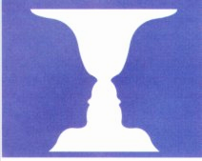
Figure and Ground
Gestalt Psychologists also thought that an important part of our perception was the organization of a scene in to its:
Figure—the object of interest
Ground —the background
Notes:
Discovering PSY p. 105 Figure 3.12

Slide 5
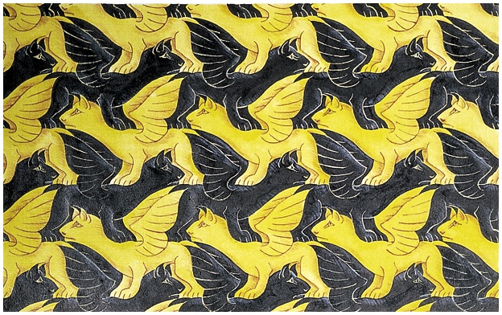
Notes:
Discovering PSY p. 106 Photo top of page

Slide 6
Gestalt Grouping Principles
Gestalt theorists argued that our perceptual systems automatically organized sensory input based on certain rules
Proximity
Similarity
Closure
Good Continuation
Common Movement
Good Form

Slide 7
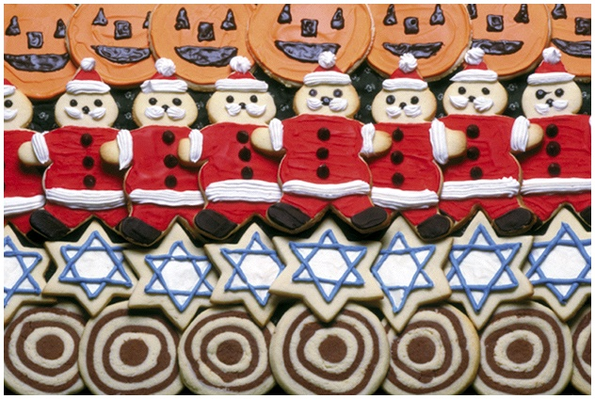
Notes:
Discovering PSY p. 106 Figure 3.14a

Slide 8
Depth Perception
One of our more important perceptual abilities involves seeing in three-dimensions
Depth perception is difficult because we only have access to two-dimensional images
How do we see a 3-D world using only the 2-D retinal images?

Slide 9
Depth Perception Cues
Cue—stimulus characteristics that influence our perceptions
We are able to see in 3-D because the visual system can utilize depth cues that appear in the retinal images

Slide 10
Types of Depth Cues
Depth cues are usually divided into categories, we will consider two types
of depth cues:
Monocular—depth cues that appear in
the image in either the left or right eye
Binocular—depth cues that involve comparing the left and right eye images
Notes:
Might also talk about convergence here

Slide 11
Monocular Depth Cues
Relative image size
Linear perspective
Texture gradient
Overlap
Aerial perspective
Motion parallax

Slide 12
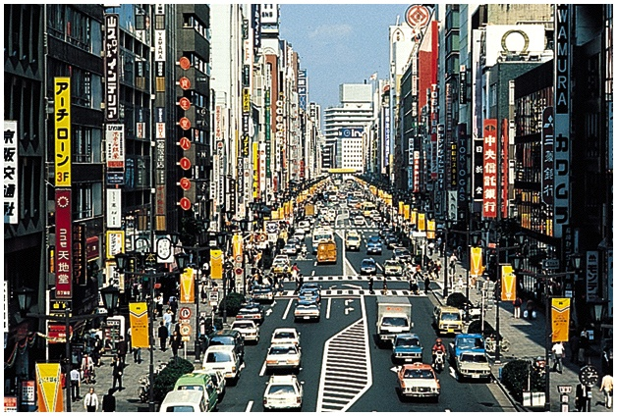
Notes:
Discovering PSY p. 109 Photo

Slide 13
Binocular Depth Cues
Our best depth perception occurs if we look through both eyes
This is because our right and left eyes see a slightly different view of the world this is called binocular disparity
Convergence is the degree to which your eye muscles must rotate to see an object.

Slide 14
Stereogram
Another way to create the illusion of depth through binocular with a stereogram
A stereogram is formed by superimposing two repeating patterns
The two patterns are slightly offset; when viewed properly, this offset is seen as a binocular disparity

Slide 15
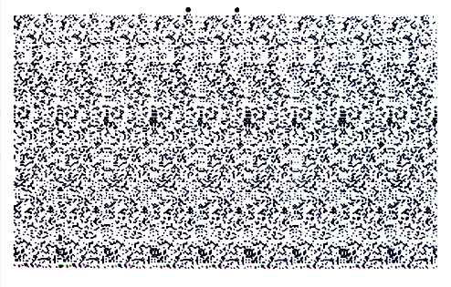
Stereogram
Notes:
Hockenbury powerpoint (Schulman)
This image should be viewed by crossing the eyes until the two target circles at the top are seen as three. What you will see is a checkerboard pattern.

Slide 16
Perception of Motion
Process that is not very well understood
Usually assume that the figure is moving and the ground is stationary
Stroboscopic motion--perception of motion caused by carefully timed flashing lights

Slide 17
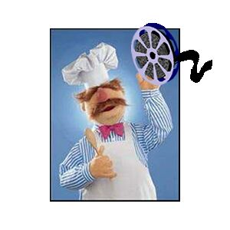
PhiPhenomenon
Apparent motion

Slide 18
Perceptual Constancy
When viewing conditions change, the retinal image changes even if the objects being viewed remain constant
Example: as a person walks away from you, their retinal image decreases in size
Important function of the perceptual system is to represent constancy in our environment even when the retinal image varies

Slide 19
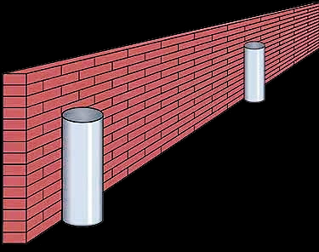
Size Constancy
Cylinders at positions A and B are the same size even though their image sizes differ
The depth cues such as linear perspective and texture help the visual system judge the size accurately
Point B
Point A
Notes:
Hockenbury powerpoint (Schulman)

Slide 20
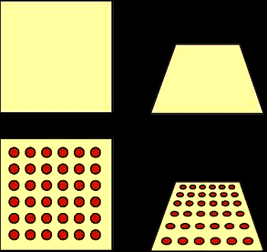
Shape Constancy
It is hard to tell if the figure on the upper right is a trapezoid or a square slanted backward
If we add texture, the texture gradient helps us see that it is actually a square
Notes:
Hockenbury powerpoint (Schulman)

Slide 21

Perceptual Completion

Slide 22
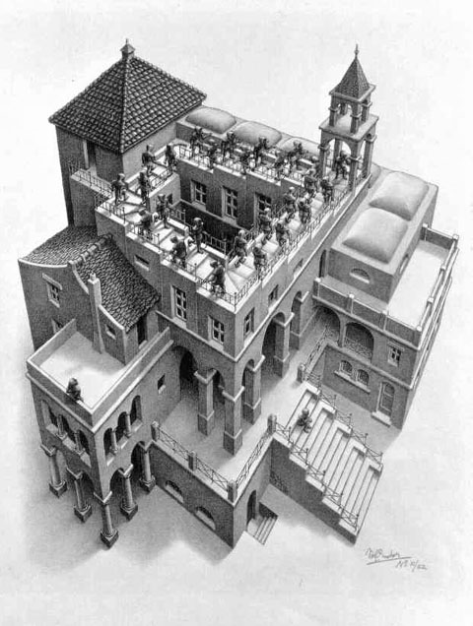

Slide 23
Some Perceptual Illusions

Slide 24



Relationship Between Perceived
Size and Perceived Depth
To perceive the size of objects accurately we must also perceive their distance accurately
Thus, many visual illusions occur simply because a particular image lacks sufficient depth cues
Retina
Pupil
Image
A
B
Image
A
This figure shows that image size depends upon both object size and distance
Notes:
Hockenbury powerpoint (Schulman)
Key point here: The retinal image is the same for the near and distant objects.
For this to happen the distant object must be larger.

Slide 25
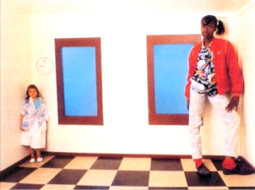
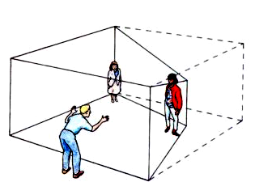
Ames Room
The Ames room is designed so that the monocular depth cues give the illusion that
the two people are equally far away
Notes:
Hockenbury powerpoint (Schulman)

Slide 26
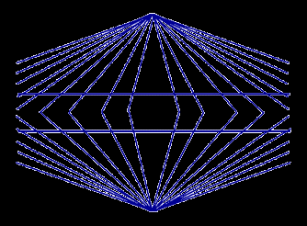
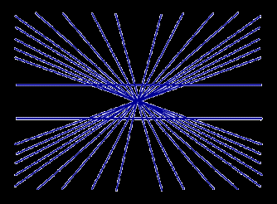
Müller-Lyer Illusion
Notes:
Hockenbury powerpoint (Schulman)

Slide 27
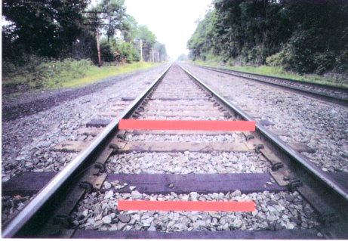
Ponzo Illusion
Converging lines indicate that top line is farther away than bottom line
Notes:
Hockenbury powerpoint (Schulman)

Slide 28
